Slide 1
Handwritten Text Recognition
Easwari Engineering College
Department of Computer Science and Engineering
Student Members :
Sai Krishna.R (310618104079)
Saketh Raman.R (310618104080)
Yuteesh.S (310618104120)
Supervisor:
Mr.P.Baskaran
Associate Professor

Slide 2
Objective
Easwari Engineering College
Department of Computer Science and Engineering
To identify handwritten characters with the use of neural networks.
To construct suitable neural network and train it properly.
The program should be able to extract the characters one by one and map the target output.

Slide 3
Motivation
Easwari Engineering College
Department of Computer Science and Engineering
Even in this digitalization era, we see documents and data being handwritten. These documents are hard to collect, transport, and preserve.
So, many organizations employ people to store data in systems manually, which is both a time and resource-consuming process.
Hence a requirement for automatic Handwritten Text Recognition system arises in order to recognize texts in scanned images.

Slide 4
Literature Survey
Easwari Engineering College
Department of Computer Science and Engineering
Pattern Recognition-Recognition of Handwritten Document Using Convolutional Neural Networks, IEEE Conference.
Keywords - Pattern Recognition, Handwritten Documents Recognition, Convolutional Neural Networks(CNN) ,Deep Learning.
Conclusion : The Convolutional Neural Network (CNN) adds significant improvements to the approach of Handwritten Document Character Recognition. Deep learning offers most efficient methods to give a successful result in this system.

Slide 5
Issues in the Existing Systems
Easwari Engineering College
Department of Computer Science and Engineering
Not enough dataset is available to make accurate predictions.
Accuracy of existing systems is lower.
The issue is that there’s a wide range of handwriting – good and bad. This makes it tricky for programmers to provide enough examples of how every character might look. Plus, sometimes, characters look very similar, making it hard for a computer to recognise accurately.

Slide 6
Proposed System
Easwari Engineering College
Department of Computer Science and Engineering
Using TensorFlow and neural networks, a model is made and trained in python.
An image of the Handwritten Text is fed to the system.
Using neural networks, the input text is processed and the recognized text is given as output along with the accuracy probabilty.

Slide 7
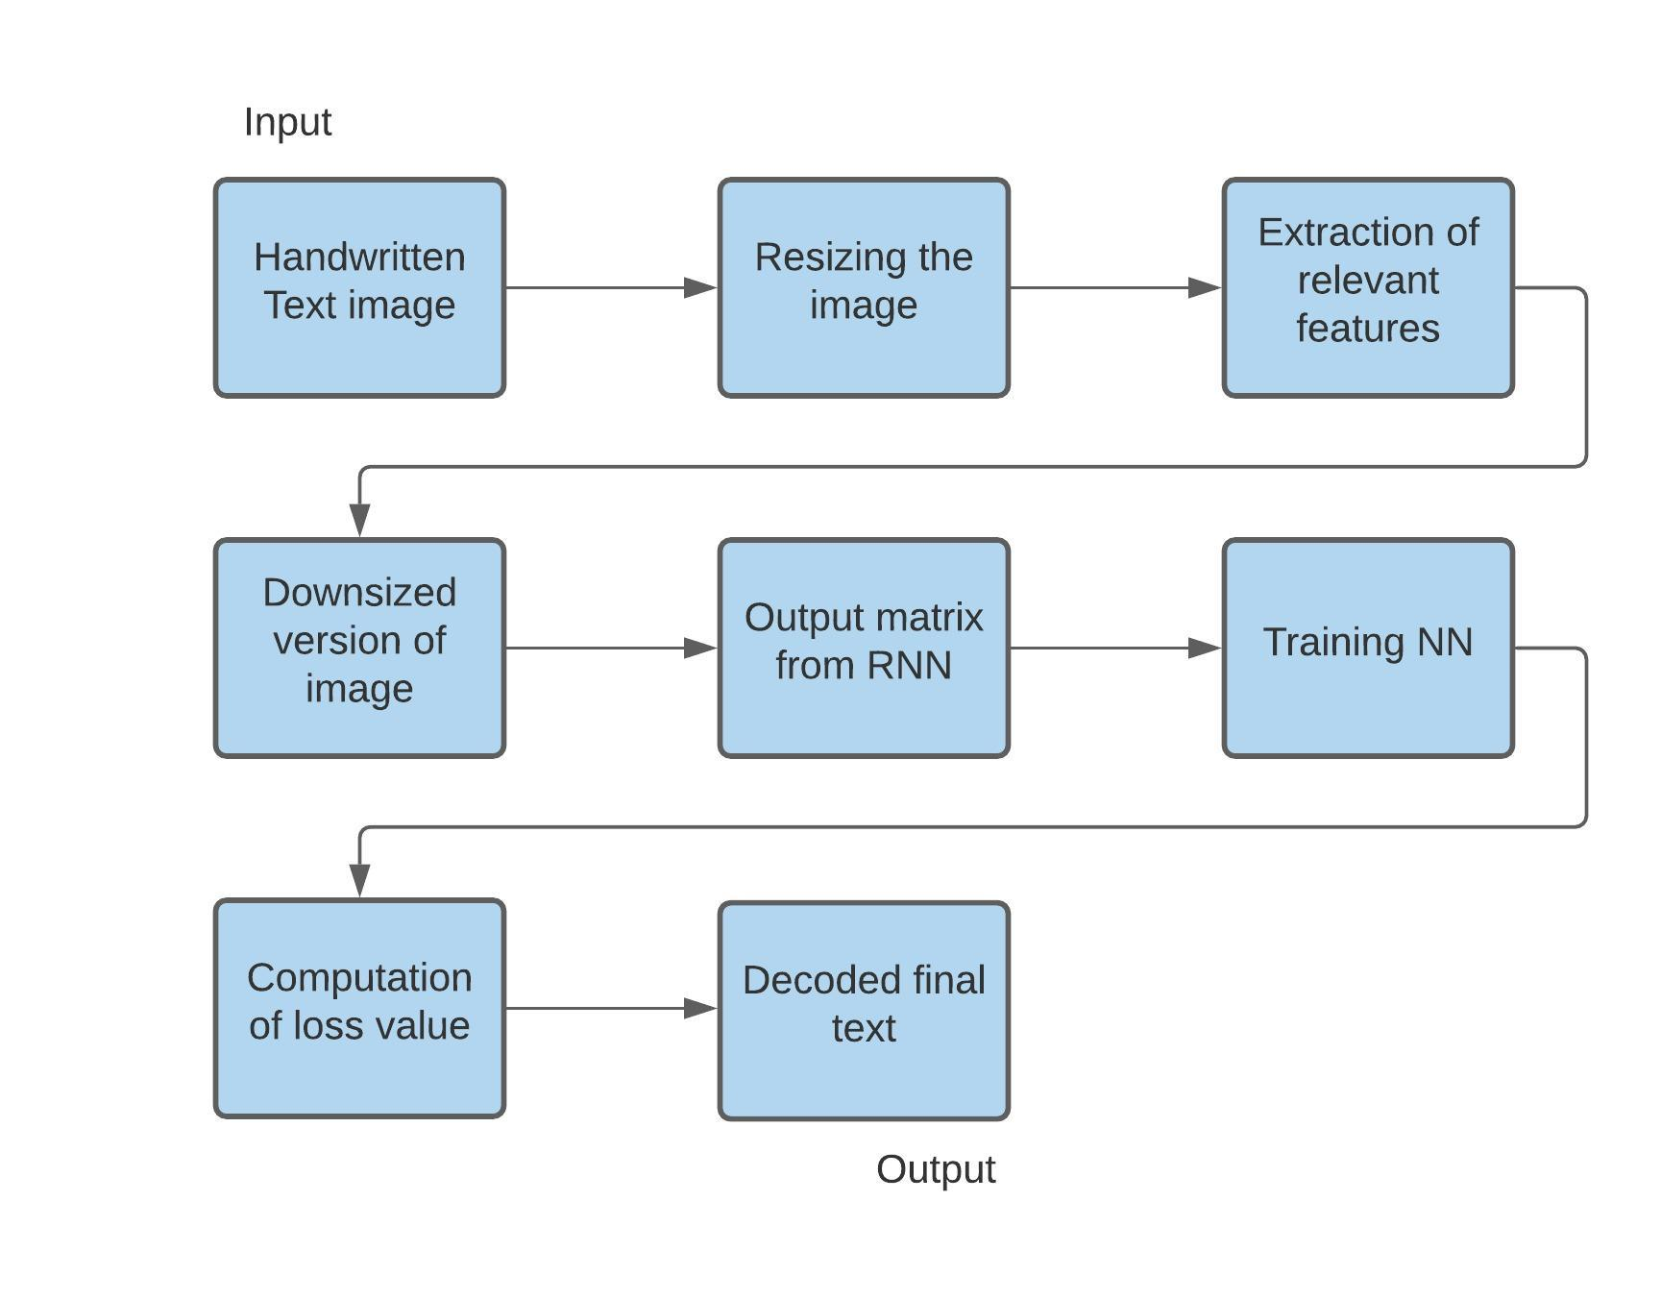
System Architecture
Easwari Engineering College
Department of Computer Science and Engineering

Slide 8
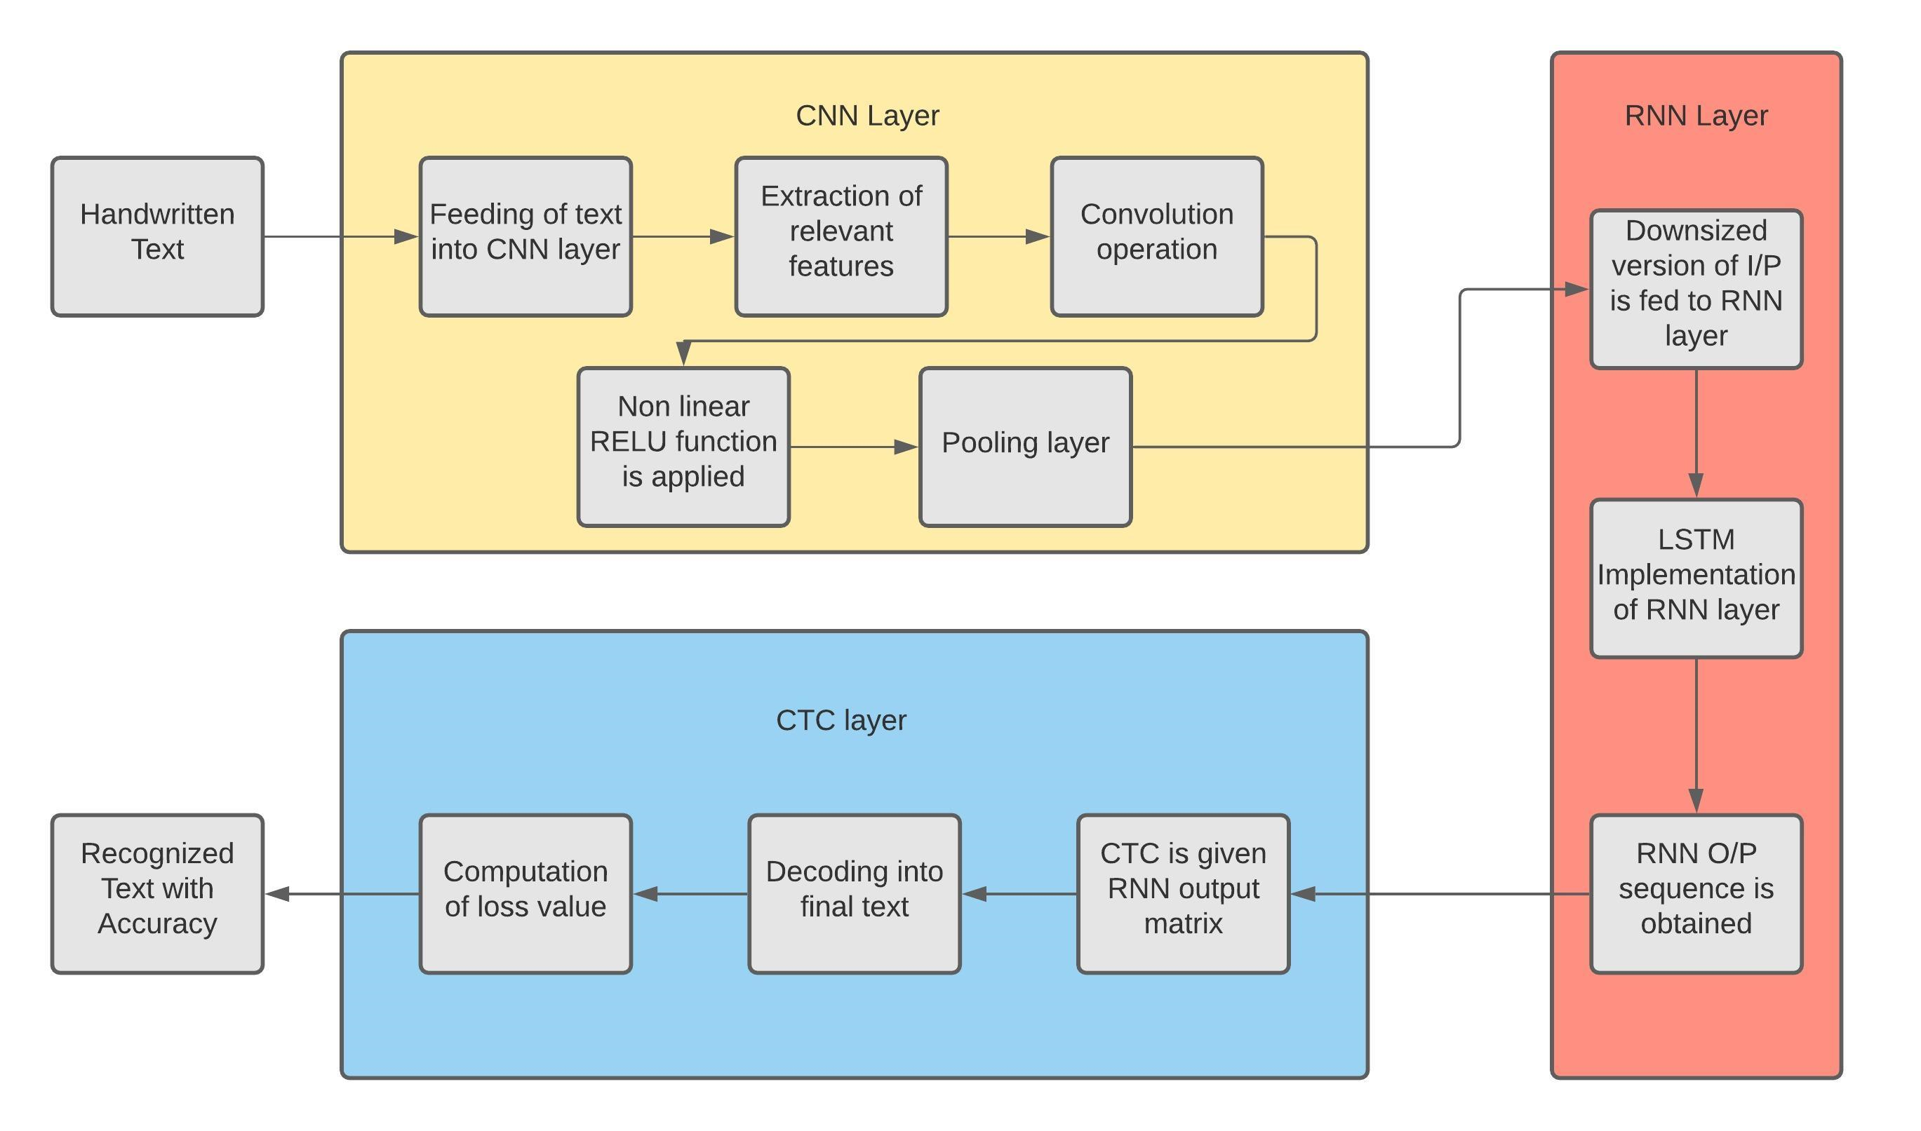
Functional Architecture
Easwari Engineering College
Department of Computer Science and Engineering

Slide 9
List of Packages
Easwari Engineering College
Department of Computer Science and Engineering
editdistance
lmdb
matplotlib
numpy
opencv
path
tensorflow

Slide 10
List of Modules
Easwari Engineering College
Department of Computer Science and Engineering
SamplePreprocessor.py
DataLoader.py
Model.py
main.py

Slide 11
Input and Output of System
Easwari Engineering College
Department of Computer Science and Engineering
Input data : Handwritten Text of the English language.
Expected Output of the System : Recognized English word along with the accuracy probabilty.

Slide 12

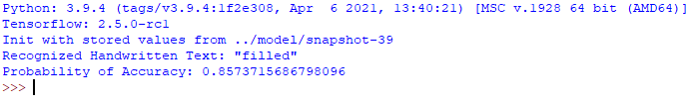
Easwari Engineering College
Department of Computer Science and Engineering
Input :
(test.png)
Output :

Slide 13
SamplePreprocessor.py
Easwari Engineering College
Department of Computer Science and Engineering
The SamplePreprocessor.py prepares the images from the IAM dataset for the NN.

Slide 14
DataLoader.py
Easwari Engineering College
Department of Computer Science and Engineering
DataLoader.py module reads samples, puts them into batches and provides an iterator-interface to go through the data.

Slide 15
Model.py
Easwari Engineering College
Department of Computer Science and Engineering
Model.py module creates the model as described above, loads and saves models, manages the TF sessions and provides an interface for training and inference.

Slide 16
main.py
Easwari Engineering College
Department of Computer Science and Engineering
main.py module puts all previously mentioned modules together.

Slide 17
System Requirements
Easwari Engineering College
Department of Computer Science and Engineering
OS : Windows 7 or higher
Developmental tools : VS Code
-Language Platform : Python 3.9 interpreter
SDK and languages : Python
- Language platform : Python 3.9 interpreter
- SDK : TensorFlow
- Development environment : VS Code
Peripheral requirements : Internet Connection, mouse, keyboard
IAM Dataset
Database : Local Storage

Slide 18
References
Easwari Engineering College
Department of Computer Science and Engineering
1.Pattern Recognition-Recognition of Handwritten Document Using Convolutional Neural Networks,
IEEE Conference.
2.Neural networks, A.E. Karnga ,
IEEE Conference.

Slide 19
Easwari Engineering College
Department of Computer Science and Engineering
Thank You

